Slide 1
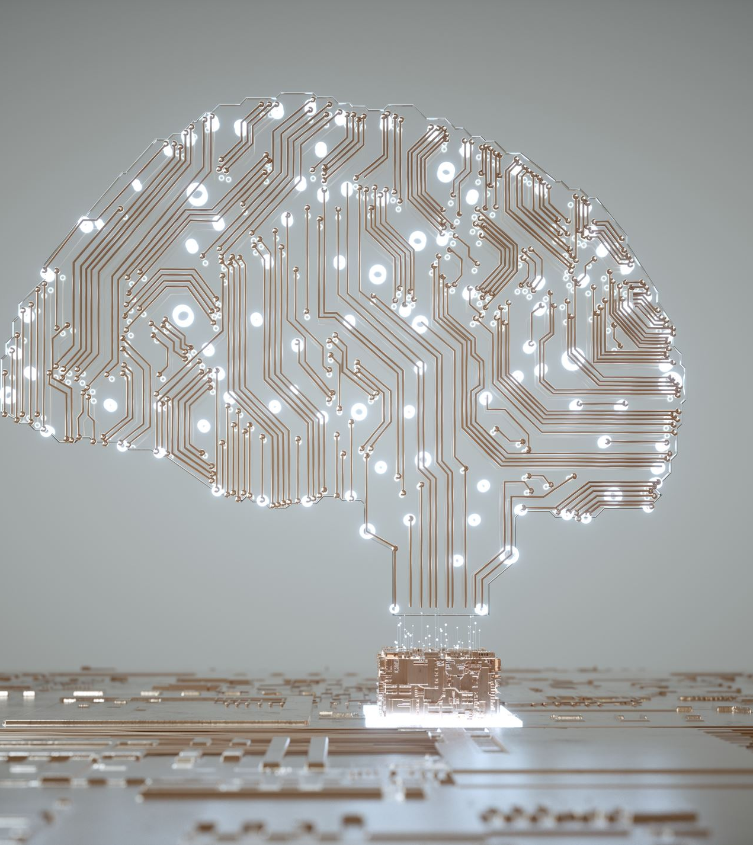
Artificial Intelligence
Utilizing Google's Teachable Machine
Notes:
Designed by Melissa Daoud and Devendra Ranjan for the Makerspace Career Academy.

Slide 2
Agenda
1. Introduce Artificial Intelligence
2. Discuss AI and its use in real life
3. Introduce Teachable Machine and its interface/tools
4. Demo: Train the Machine to recognize images
5. Project: Create the snake game
6. Walk through the snake game's files, discussing what the code does.
Notes:
Machine learning: This type of learning provides machines the ability to learn from past experiences (i.e. via data) which allows for better pattern recognition and predictions with minimal human intervention (spiceworks.com).
Neural networks: A method used to teach computers to process data in a way that is similar to the human brain (aws.amazon.com).
Natural language processing: A branch of artificial intelligence that enables computers to comprehend, generate, and manipulate human language (oracle.com).

Slide 3
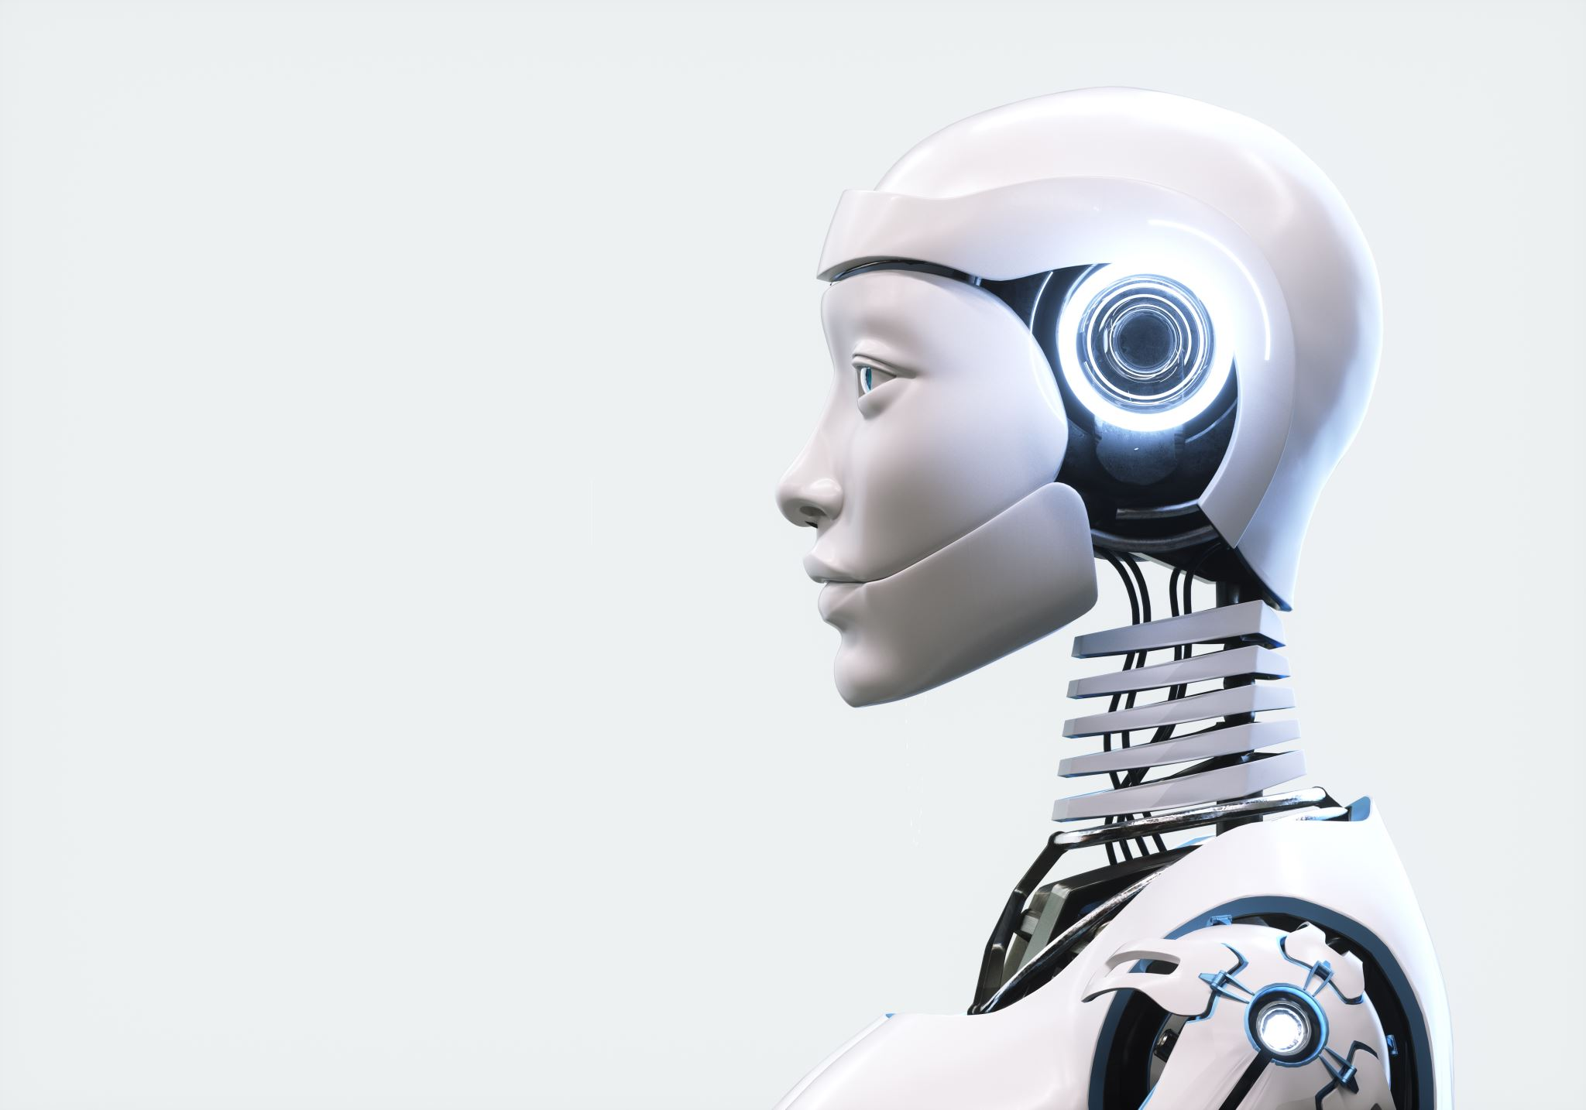
What is Artificial Intelligence (AI)?
AI, or Artificial Intelligence, is the study and development of computer systems that mimic human intelligence to perform tasks.
AI encompasses a range of technology such as: machine learning, neural networks, natural language processing, and robotics.
Notes:
Machine learning: This type of learning provides machines the ability to learn from past experiences (i.e. via data) which allows for better pattern recognition and predictions with minimal human intervention (spiceworks.com).
Neural networks: A method used to teach computers to process data in a way that is similar to the human brain (aws.amazon.com).
Natural language processing: A branch of artificial intelligence that enables computers to comprehend, generate, and manipulate human language (oracle.com).

Slide 4
I spy...AI!
Where have you seen AI being used?
How do you use AI in your daily life?
What do you think the future with AI looks like?
Notes:
Machine learning: This type of learning provides machines the ability to learn from past experiences (i.e. via data) which allows for better pattern recognition and predictions with minimal human intervention (spiceworks.com).
Neural networks: A method used to teach computers to process data in a way that is similar to the human brain (aws.amazon.com).
Natural language processing: A branch of artificial intelligence that enables computers to comprehend, generate, and manipulate human language (oracle.com).

Slide 5
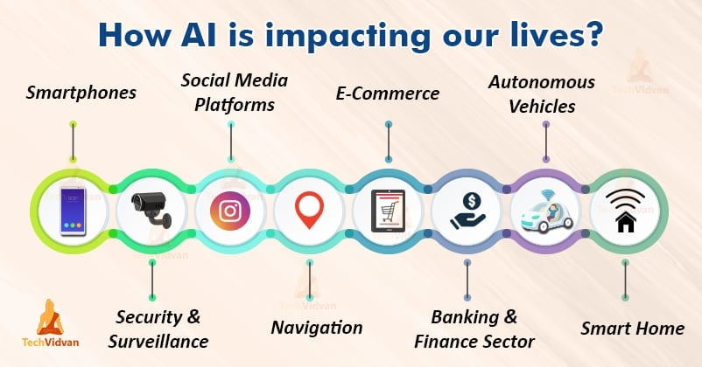
Notes:
Machine learning: This type of learning provides machines the ability to learn from past experiences (i.e. via data) which allows for better pattern recognition and predictions with minimal human intervention (spiceworks.com).
Neural networks: A method used to teach computers to process data in a way that is similar to the human brain (aws.amazon.com).
Natural language processing: A branch of artificial intelligence that enables computers to comprehend, generate, and manipulate human language (oracle.com).

Slide 6
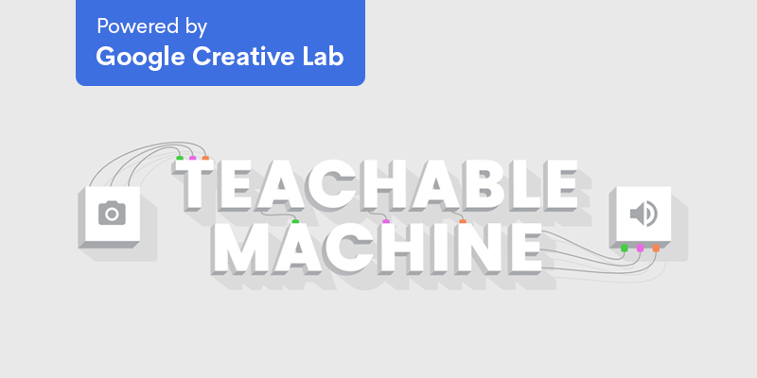

Slide 7

Teachable Machine is a web-based application.
You teach the machine via 'classes' that hold multiple instances of images, sounds, or poses that you provide either via file or webcam.
A model is then trained to recognize these instances.​
Once a model has been trained and tested successfully, it can then be used in projects, sites, applications, and more. ​

Slide 8

How to Train the Machine
Train a model via machine learning on the browser.
- You can train the machine with images, audio, and poses.
Collect data and classify them with labels.
Collect roughly 130 images/poses as a starting point.
Teachable Machine will then use something called "Transfer Learning" to train itself to recognize the data presented to it.

Slide 9

What is Transfer Learning?
Makes use of a previously trained, foundation model – called MobileNet. The training data used for a model is called ImageNet.
The model first scans any images presented to it and breaks them down into different numerical points.
The model then uses those points to recognize the images shown to it.
MobileNet already has a small library of images that it recognizes automatically.
For example, it can recognize items like radios and umbrellas as well as some animals, like toucans and bullfrogs.

Slide 10
Part 1: DEMO - Teaching the Machine to Recognize an Image
Go to https://teachablemachine.withgoogle.com/train
Click on "Image Project," then click on "Standard image model"
Add the image samples – one run of testing (roughly 130 images) should be enough.
Train the model.
Test the model.

Slide 11
Part 2: Creating an Image-Based Controller
Now that you've gained some familiarity with Teachable Machine, we are going to create a controller to play the Snake Game.
Create gestures for UP, DOWN, RIGHT, LEFT, and NOTHING.
Train the model.
Test the model.
If the model recognizes your poses with 100% accuracy (if not very close to) export the model and link it to the Snake Game code.

Slide 12
Part 3: Creating the Snake Game
Download the code files for the Snake Game from the Makerspace GitHub.
https://github.com/Macomb-Makerspace/Makerspace_Academy_2024/blob/main/3_Google's%20Teachable%20Machine/Completed_Snake_Game.zip
Create a new p5.js project and transfer the necessary files.
Open the project in Visual Studio Code.
Link your model to the code.
Walk through the code to see what's happening when.
Play the game!

Slide 13
Snake Game: How Does it Work?
The Snake Game is coded in p5.js.
P5.js is a JavaScript library that focuses more on visual design whereas JavaScript is a standard for web development. (aircada.com)
Ml5.js is another JavaScript library that focuses on machine learning, making it more accessible by artists and creative coders. (w3.org)
The Snake Game is written in JS code and utilizes Classes, Objects, Functions, and Event Listeners.

Slide 14
Snake Game: Classes and Objects
A Class can be considered the "blueprint" of a thing. It contains all the characteristics and actions said thing could have. For example, a Car class would have characteristics of make, model, and color. The actions of the Car could be forward, reverse, and brake.
An Object is a copy of a class. In our Car class example, a Ford Focus could be a possible object.

Slide 15
Snake Game: Functions and Event Listeners
A Function contains code necessary for an action to occur. For example, pressing the brake pedal in a car will make the car slow down or stop completely.
An Event Listener is a special type of Function; it "listens" or waits for something to happen and then performs an action. For example, to move forward in a car, the car must be in "drive" before pressing the gas pedal. In code, an Event Listener would wait for the gas pedal to be pressed and, when it is, the code will tell the car to move forward.

Slide 16
Sources
Teachable Machine:
https://teachablemachine.withgoogle.com/train/image
Makerspace GitHub:
https://github.com/Macomb-Makerspace
Designed by Melissa Daoud and Devendra Ranjan for the Makerspace Career Academy.

